Slide 1



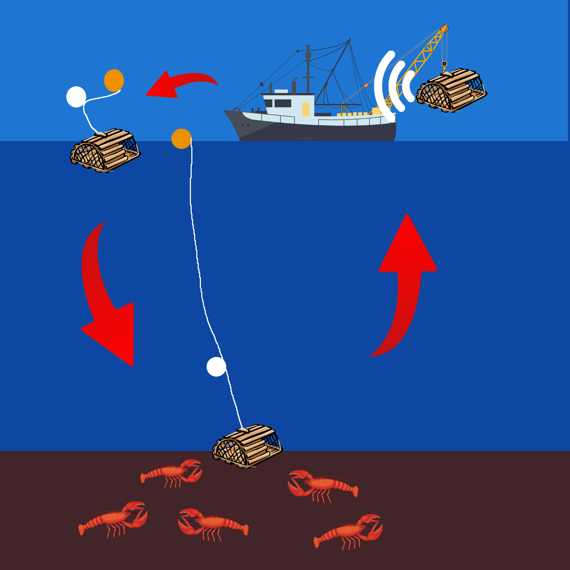
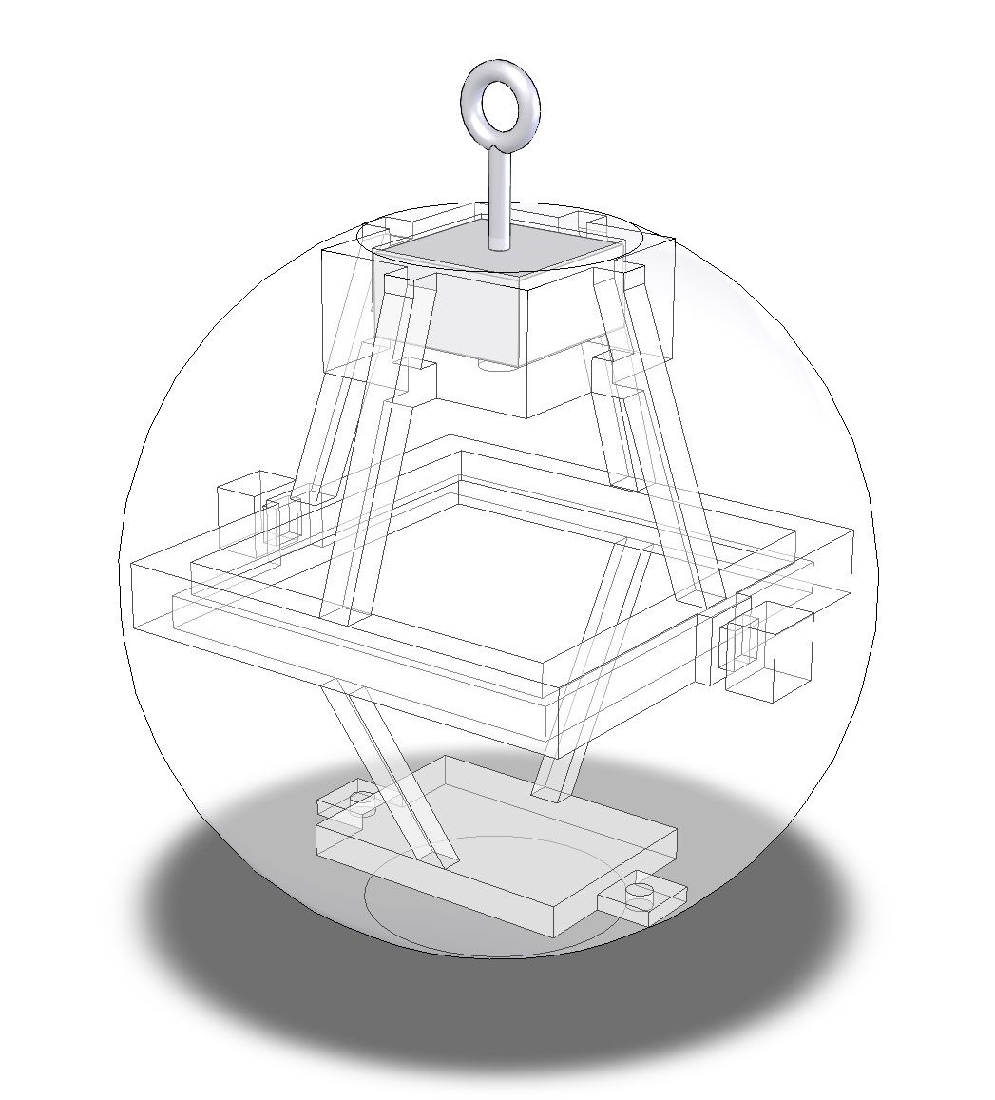
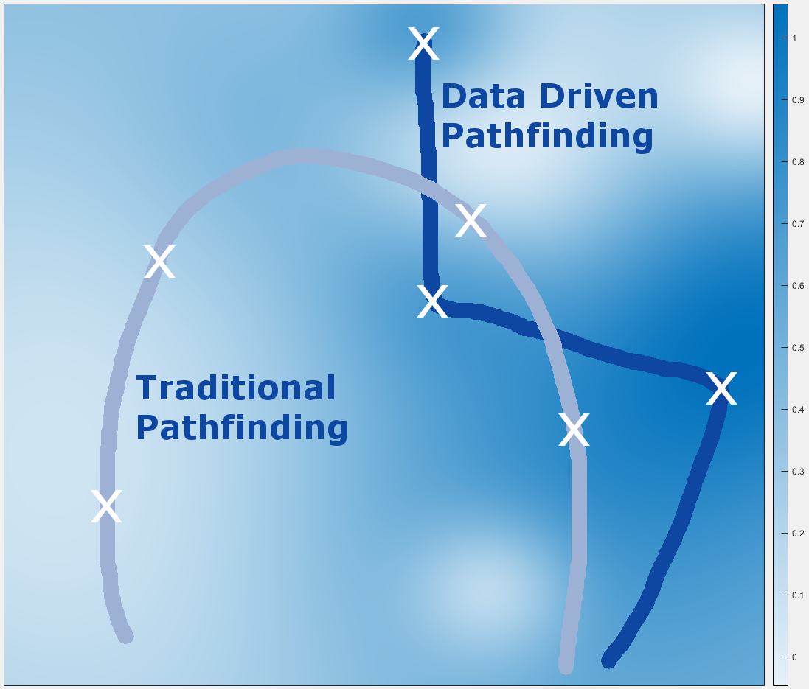
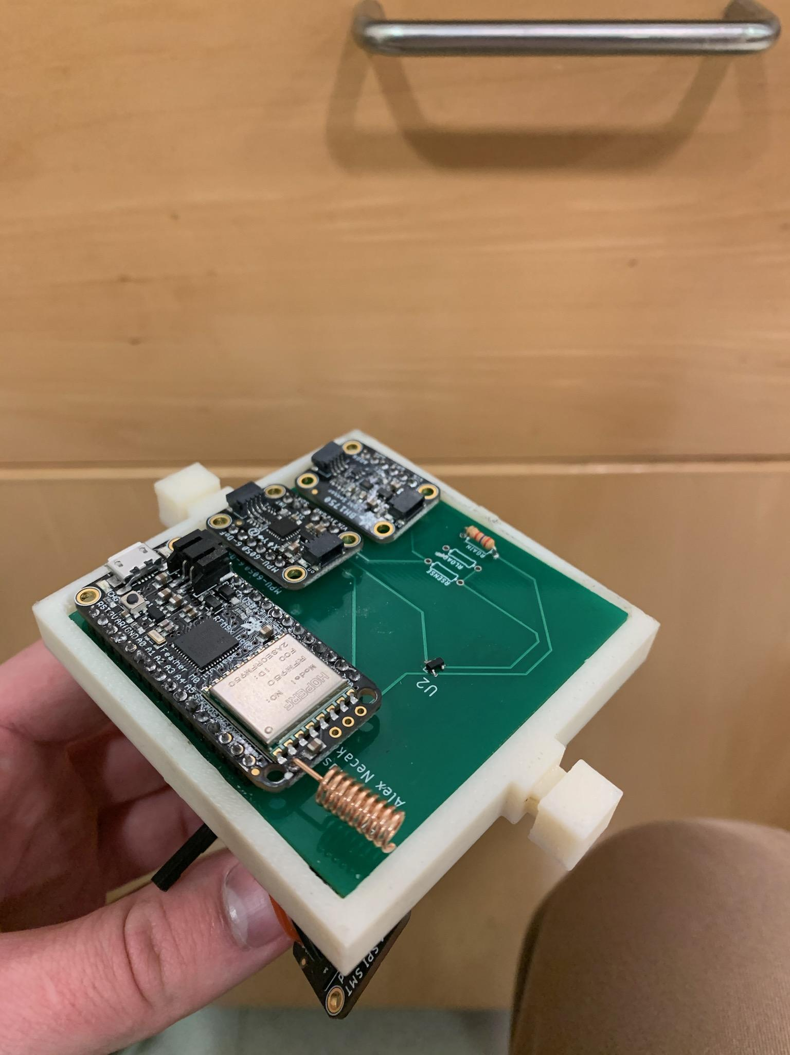
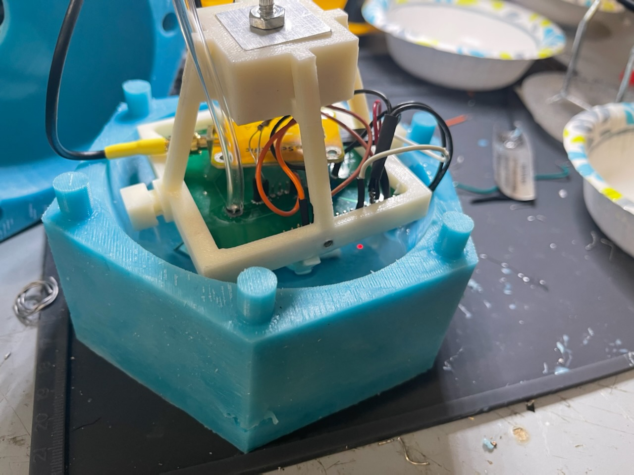
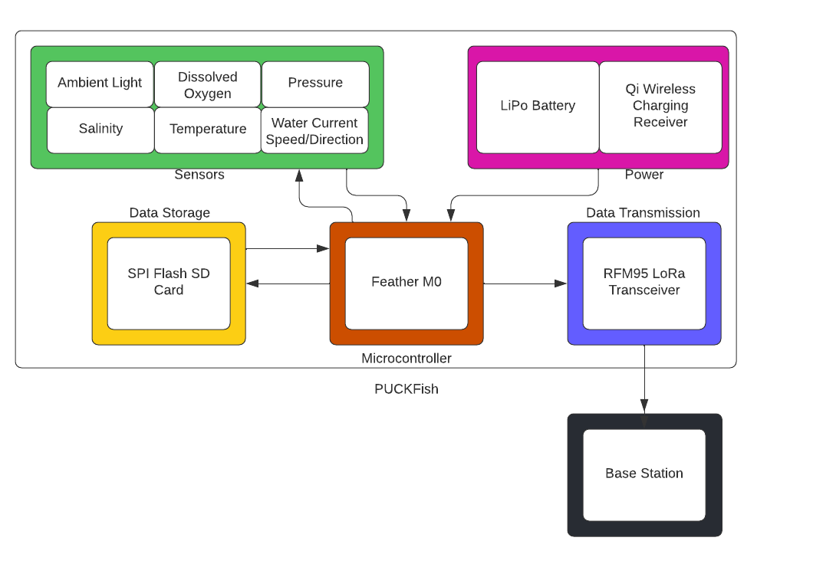


William Aracri, Peter Ha, Ammar Hussain, Alex Necakov, Victoria Thomas
Visualization
Device Design
Environmental Impact
Title of this picture
Conclusion
PUCKFish increases trap yield while decreasing operating costs and environmental impact
Automated data collection and transmission make the user experience completely painless, with trappers only needing to charge PUCKFish after use
Executive Summary
Lobster trappers utilize almost no data and place traps on dead reckoning alone
PUCKFish provides cheap, rugged instrumentation to fisheries
Provides the tools to catch larger hauls with fewer traps and less time at sea
Collects the 6 metrics most predictive of aquatic life
Dissolved oxygen, temperature, pressure, ambient light, salinity, and water current
Underwater battery life of 10 days
Charged wirelessly via Qi
Local storage protects data in case of battery death
Automatically detects surfacing and transmits data to base station
Future Direction
Future implementations of the PUCKFish will improve cost by using a cheaper radio module, as LoRa is not needed for the expected transmission distances
The polling rate to collect data on the boards can be adjusted on later units to pull more or less frequently depending on the needs of the customer
PUCKfish Video
User’s Manual

